Slide 1
Undergraduate Research is for
YOU
Learn. Explore. Research. Create.
Workshops: How to Get Started in Research
Friday, 11/4 | SOND 103 | 12-1

Slide 2
Summer Opportunities
Start NOW to find summer research
National Science Foundation:
www.nsf.gov/crssprgm/reu/reu_search.cfm
Many offer summer stipend, housing, travel allowance
Applications typically due early, often by February 1
Opportunities for all majors, including non-STEM
ur.umbc.edu/summer-research/
http://www.urop.uci.edu/opportunities.html

Slide 3
Undergraduate Research Award
Grants of up to $1,500 to students for research or creative work with the guidance of a faculty mentor
Proposals (two pages only) for funding starting in the summer for the academic year, 2017 - 2018
Undergraduate Research Award site: ur.umbc.edu/ura/
Workshops Wednesday, 11/16| Sondheim 103 | 12-1
Tuesday, 12/6 | Sherman 113 | 3-4:30
Applications accepted February 2017

Slide 4
Undergraduate Research & Creative Achievement Day (URCAD)
http://ur.umbc.edu/urcad
On-campus student research conference
Students doing a thesis, independent study project, capstone project, or other research/creative work with a faculty member should apply to present their project.
Applications (200 words) accepted February 1 to 24, 2017
Event: Wednesday, April 26, 2017

Slide 5
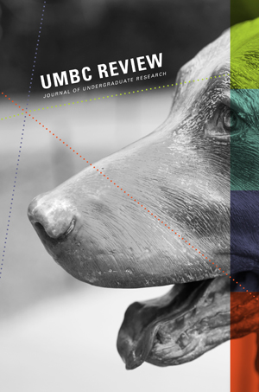
UMBC Review: Journal of Undergraduate Research
The UMBC Review: ur.umbc.edu/umbc-review/
Published annually
For academic papers written by
UMBC undergrads
Submit in May for the 2018 issue
Contact: umbcreview@umbc.edu

Slide 6
For more information about Undergraduate Research:
http://ur.umbc.edu/
Contact: Janet McGlynn
mcglynn@umbc.edu
410-455-5754
myUMBC group: Undergraduate Research
FaceBook: Undergraduate Research@UMBC

