Slide 1
TITLE
Full Name
Mentor:
April 10, 2024
Undergraduate Research and Creative Achievement Day

Slide 2
INTRODUCTION OR BACKGROUND INFORMATION
This should be written as an introduction to your topic and with language that a non-specialist in the field can understand. Define terms. Discuss previous work in the field (from your lit review).

Slide 3
LITERATURE REVIEW
2-3 main sources that influenced your work

Slide 4
RESEARCH QUESTION
Hypothesis/Thesis
Your research objective/hypothesis should clearly state the problem under study and why it is significant. Will it resolve this problem for the first time or in a way that has not succeeded previously?

Slide 5
METHODS
How did you study your subject?
What instruments, participants, or technology did you use?
How was this method unique (used something for the first time or in a way it had not been used before?)
How does your method match your subject?
Theories, histories, equipment, tools

Slide 6
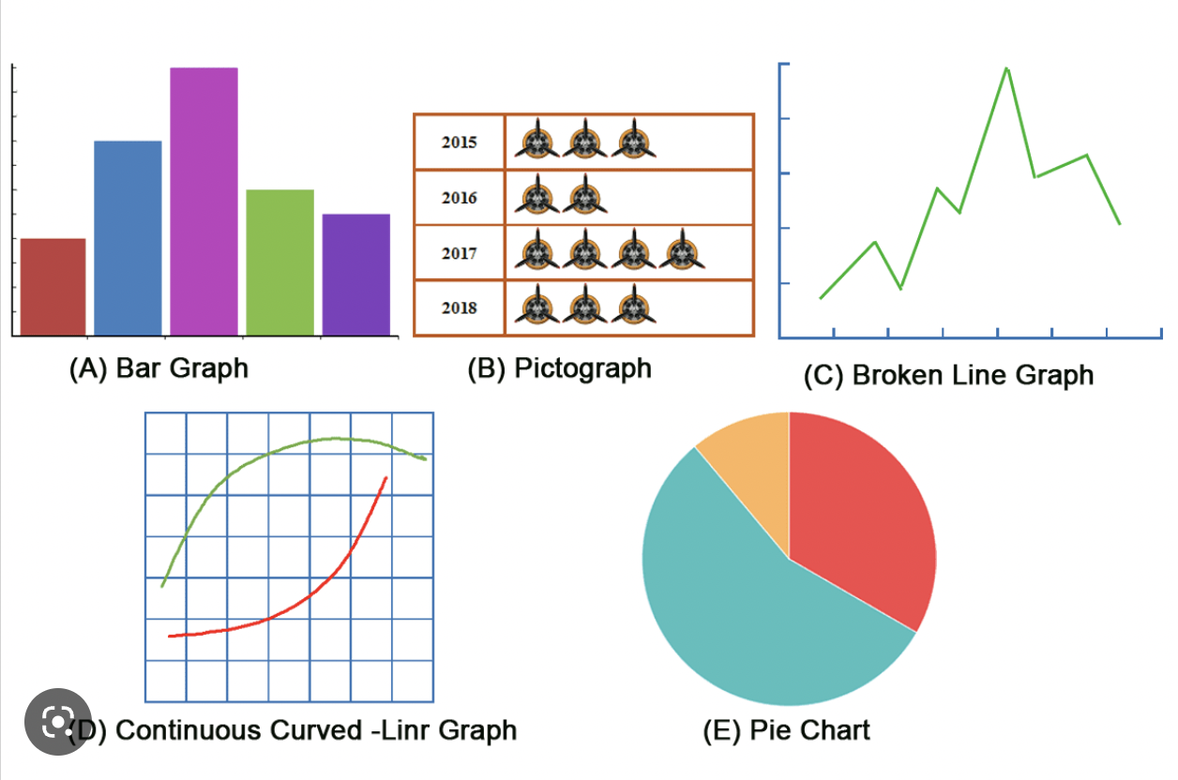
RESULTS/DATA
Findings, data, graphs and figures
Use bullets for clarity
Always label charts and graphs
Describe each graphic for accessibility purposes

Slide 7
DISCUSSION
Major findings, significance of the study, impact on the research community. Interpretation- what do your results mean?

Slide 8
LIMITATIONS/FUTURE DIRECTIONS
Applications, how the study can be used by other researchers, how you may take the study forward with more research. What new questions might you ask as a result of this new knowledge?

Slide 9
ACKNOWLEGEMENTS
Funding sources and other professional thank-yous, including your mentor(s), and department. Do not thank friends or family here- keep it professional.

