Slide 1
Undergraduate Research at UMBC
&
Regulatory Requirements to Conduct It
Fall 2025
Office of Research Protections and Compliance
Emily Redding – IRB
Katie Bankert – IACUC/IBC

Slide 2
What does the Office of Research Protections and Compliance do?
We are a centralized resource at UMBC to ensure that faculty, staff and students conduct research activities in a manner consistent with federal, state, and institutional regulatory requirements.
Committees that fall under our office:
Department of Animal Welfare Assurance (AWA) – IACUC Committee
Department Biosafety Research & Guidance (BRG) – IBC Committee
Human Research Protections and Integrity (HRPI) – IRB Committee
Additional Areas of Compliance:
Export Control
Conflict of Interest
Responsible Conduct of Research
Facilitate training and education
Post approval monitoring of approved research

Slide 3
Where do the Regulatory Committees get their guidance and authority?
Federal Regulations
State
Regulations
UMBC Policies and Procedures
Compliance Committees
University Administration
IRB (Human Subjects)
IACUC (Animal Use)
IBC (Biosafety)
DHHS (45 CFR 46) OLAW
FDA (21 CFR 56) PHS
USDE (34 CFR 97 ; 34 CFR 99) NIH
State of Maryland
University System of Maryland
Office of Research and Creative Achievement (ORCA)
IRB IACUC/IBC

Slide 4
What is an Institutional Biosafety Committee (IBC)?
The IBC is responsible for ensuring that the use of recombinant DNA in research and teaching labs as well as research and teaching involving infectious agents, select agents, and biological toxins research done at or sponsored by UMBC, regardless of funding, is conducted in compliance with the NIH Guidelines and the Biosafety in Microbiological and Biomedical Laboratories 6th edition (BMBL) with proper concern for the safety of research and teaching personnel, the environment, and the surrounding communities.
What does the IBC review?
  Review of recombinant and synthetic DNA in research and teaching labs as well as research and teaching with transgenic animals and biohazardous materials (such as bacterium, fungi, algae, potential infectious agents and select agents) conducted at, or sponsored by, the UMBC for compliance with the NIH Guidelines, and the Biosafety in Microbiological and Biomedical Laboratories 6th edition (BMBL). ALL research and teaching activities related to the above is subject to IBC oversight; the source of the funding does not alter this requirement.
  Independent assessment of the containment levels required by the NIH Guidelines
  Assessment of the facilities, procedures, practices, and training and expertise of the personnel involved in recombinant or synthetic nucleic acid/infectious agent research
  Ensure that all relevant aspects of the NIH Guidelines have been appropriately addressed by the Principal Investigator and Lab Instructor.
  Ensure that no research participant is enrolled in a human gene transfer experiment until the NIH Recombinant DNA Advisory Committee (RAC) review process has been completed, Institutional Review Board approval has been obtained, and all applicable regulatory authorizations have been obtained
IBC Membership:
The IBC, as a group, must be sufficiently qualified through the experience, expertise, and diversity of its members to be able to review the research activities commonly conducted by the institution. The IBC must be comprised of at least 5 individuals with diverse backgrounds including:
  At least one Plant Expert
  At least one Animal Expert
  Biosafety Professional (this could be someone from EHS)
  One member who is not otherwise affiliated with UMBC (a community member!)

Slide 5
Biosafety and Laboratory Safety Training
Biosafety training is required for all principal investigators, research staff, and lab instructors involved in research or teaching in their laboratories to ensure each person understands specific hazards associated with work in the lab and know how to protect themselves from such hazards in the areas specific to the research.
Training can be accessed through CITI: https://www.citiprogram.org/
Hazardous Communication (Required)
Biosafety Complete Training series (Required)
OSHA Bloodborne Pathogen (if applicable)
Animal Biosafety (if applicable)
NIH Recombinant DNA (rDNA) Guidelines (if applicable)
Additional guidance and instructions for accessing training can be found here:
https://research.umbc.edu/2041-2/

Slide 6
What is the Institutional Animal Care and Use Committee(IACUC)?
The mission of the Institutional Animal Care and Use Committee (IACUC) is to ensure the humane care and use of animals in research, teaching and testing, and to ensure compliance with guidelines and regulations
UMBC requires that an animal research protocol, regardless of funding source, be submitted for review and approval by the IACUC (Institutional Animal Care and Use Committee) before any investigator purchases, obtains and begins research involving vertebrate species. The IACUC will review all animal use carried out in university facilities, as well as fieldwork conducted by UMBC personnel. All projects are to be approved prior to the actual use of animals, whether it involves research/teaching or warm/cold blooded vertebrates.
Students who will be conducting research with animals will need to be added to their faculty advisor’s protocol.
Research at UMBC does not include USDA regulated species. Most research is with mice, rats, fish, or observational studies of wild birds
IACUC Membership:
The IACU, as a group, must be sufficiently qualified through the experience, expertise, and diversity of its members to be able to review the research activities commonly conducted by the institution.
The ICUC must be comprised of at least 5 individuals with diverse backgrounds including:
  At least one scientist
  At least one non-scientist
  Veterinarian
  One member who is not otherwise affiliated with UMBC (a community member!)

Slide 7
Required Training for Working with Laboratory Animals
All investigators and key personnel who participate in the design and/or the conduct of animal use research must be appropriately trained in the care and humane use of animal subjects.
In person Animal Research Orientation Training with the Attending Veterinarian is Required
Required Online training is administered through CITI: https://www.citiprogram.org/
Investigator staff and researcher training (Working with the IACUC)
Animal Biosafety
Lab Animal Welfare Courses (these are listed by the type of animal you will be working with)
  I work with frogs, toads or other amphibians.
  I work with mice.
  I work with rats.
  I work with zebrafish.
  I work with wildlife in the field or in captivity
Additional guidance and instructions for accessing training can be found here:
https://research.umbc.edu/animal-care-and-use-training/

Slide 8
What is an Institutional Review Board (IRB)?
Institutional Review Boards, or IRBs, review research studies to ensure that they comply with applicable regulations, meet commonly accepted ethical standards, follow institutional policies, and adequately protect research participants.
The IRB functions assure that:
  Risks to subjects are minimized and reasonable in relation to anticipated benefits
  Privacy and confidentiality of subjects is maintained by the research team
  Promote excellence in the conduct of research
IRB Membership:
The IRB, as a group, must be sufficiently qualified through the experience, expertise, and diversity of its members to be able to review the research activities commonly conducted by the institution. Relevant considerations may include training and education, race, gender, cultural background, and sensitivity to community attitudes.
The IRB must be comprised of at least 5 individuals with diverse backgrounds including
  At least one scientist
  At least one non-scientist
  One member who is not otherwise affiliated with UMBC (a community member)

Slide 9
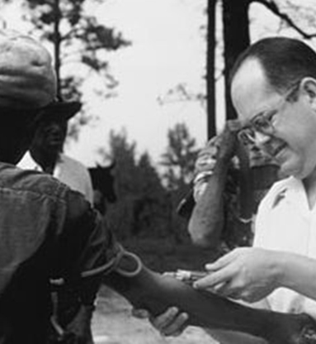
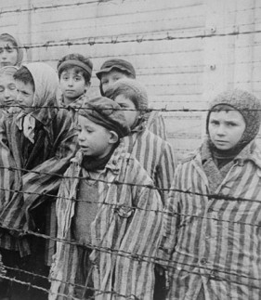
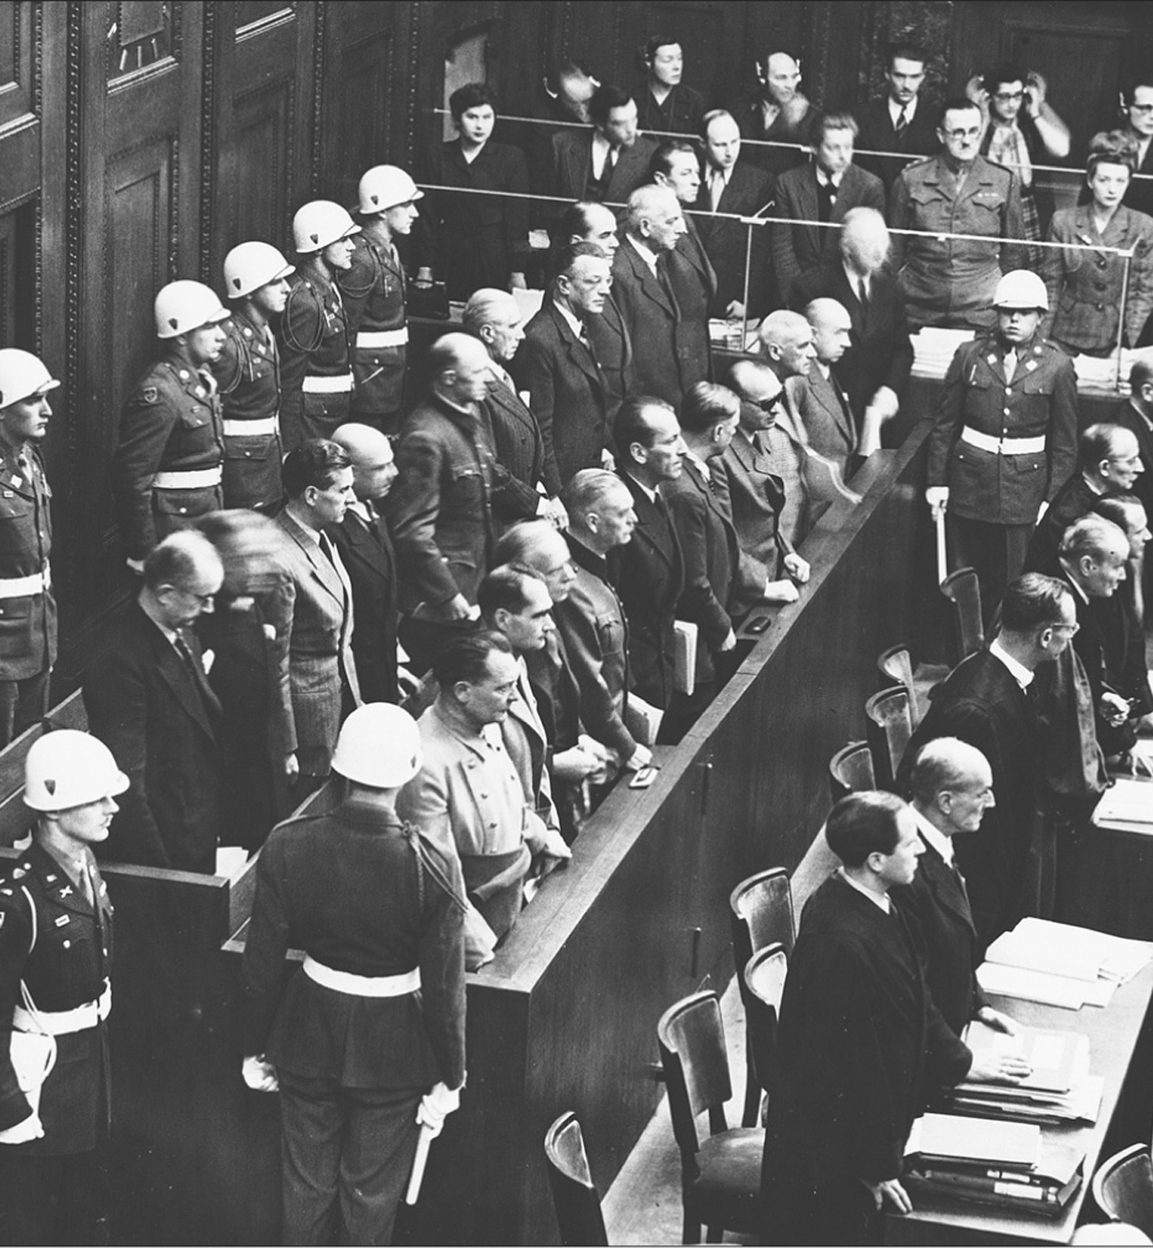




Why do IRBs Exist?
1932-1972
1942-1945
1947
1964
1974
1979
1991-Present
Tuskegee Syphilis Experiment
Nazi
Medical Experiments
Nuremberg Code
Declaration of
Helsinki
National Research Act/OHRP
Belmont Report
Common Rule
45 CFR 46
Sponsored by the US Dept of Health, Education and Welfare, investigated the effects of untreated syphilis in 400 African American men. Subjects were not informed they were in an experiment, and were instead told they were being treated for “Bad Blood”
German scientists conducted series of medical experiments on prisoners by Nazi Germany in its concentration camps.
International code of ethics required experiments to be scientifically necessary, conducted by qualified personnel and documented by informed consent
International principles that guide physicians in protecting the safety of human subjects in biomedical research while driving medical progress to help humanity as whole
Regulation for the Protection of Human subjects of Biomedical and Behavioral Research, established the role of IRBs, to protect human subjects in clinical research
The national commission of ethical guidelines for the protection of human subjects in clinical research established three core principles: respect, beneficence, and justice
Current set of federal regulations that protect human research participants. Modified in 2018.
Notes:
Examples of human research were atrocities occurred that harmed individuals or investigators believed they were “doing the right thing”. Timeframes, knowledge of known risks and harms and absences of human research regulations factor in.
Nuremberg Code: Developed in response to experiments conducted on concentration camp prisoners by German doctors during WWII. The Nuremberg Code established the right and the importance of voluntary participation and informed consent
Declaration of Helsinki: Statement of recommendations from the World Medical Association in 1964 (amended in 1975, 1983, 1989, 1996)
Established the following principles:
Human research should be based on successful laboratory and animal experimentation and have importance that outweighs the risk;
The investigators must be competent for the intended task;
Participants should provide informed consent;
Protocols should be reviewed by an external body to avoid investigator bias.
National Research Act: Passed in response to the Tuskegee Syphilis Study. The 40 year study monitored, but did not obtain consent or treat, 600 African American men who were infected with syphilis, even after treatment was widely available. The National Research Act created the National Commission for the Protection of Human Subjects of Biomedical and Behavioral Research with the charge of developing ethical guidelines for human research
Belmont Report:
Tearoom Trade Study: The study is an analysis of men who participate in anonymous sex with other men in public lavatories, a practice known as "tea-rooming" or "cottaging".^{[1]} Humphreys asserted that the men participating in such activity came from diverse social backgrounds, had differing personal motives for seeking sex in such venues, and variously self-perceived as "straight," "bisexual," or "gay.“
Humphreys' study has been criticized on ethical grounds in that he observed acts of homosexuality by masquerading as a voyeur, did not get his subjects’ consent, used their license plate numbers to track them down, and interviewed them in disguise without revealing the true intent of his studies (he claimed to be a health service interviewer, and asked them questions about their race, marital status, occupation, and so on Tearoom Trade has been criticized for privacy violations, and deceit
Theralizumab – 2006 Parexel immunomodulary to treat leukemia and RA. 6 patients volunteered and within 90 minutes of receiving the experimental drug they were writhing in agony as the drug had caused reactions never seen in a clinical trial before, nor in any of the pre-clinical safety tests. The reaction, dubbed by scientists “a cytokine storm”, was life threatening. Within 12 hours all were in intensive care which lasted up to 16 days as doctors fought to control the symptoms. Trials in NHP’s did not show the same cellular reaction.
Milgram - In Milgram's basic paradigm, a subject walks into a laboratory believing that they are about to take part in a study of memory and learning. After being assigned the role of a teacher, the subject is asked to teach word associations to a fellow subject (who in reality is a collaborator of the experimenter). The teaching method, however, is unconventional—administering increasingly higher electric shocks to the learner. Once the presumed shock level reaches a certain point, the subject is thrown into a conflict. On the one hand, the strapped learner demands to be set free, he appears to suffer pain, and going all the way may pose a risk to his health. On the other hand, the experimenter, if asked, insists that the experiment is not as unhealthy as it appears to be, and that the teacher must go on. In sharp contrast to the expectations of professionals and laymen alike, some 65% of all subjects continue to administer shocks up to the very highest levels.
One of the most famous studies of obedience in psychology was carried out by Stanley Milgram. The Milgram Shock Experiment raised questions about the research ethics of scientific experimentation because of the extreme emotional stress and inflicted insight suffered by the participants
Tuskegee - conducted between 1932 and 1972 by the United States Public Health Service (PHS) and the Centers for Disease Control and Prevention (CDC) on a group of nearly 400 African American men with syphilis.[4][5] The purpose of the study was to observe the effects of the disease when untreated, though by the end of the study medical advancements meant it was entirely treatable. The men were not informed of the nature of the experiment, and more than 100 died as a result.
The U.S. Public Health Service (USPHS) Syphilis Study at Tuskegee was conducted between 1932 and 1972 to observe the natural history of untreated syphilis. As part of the study, researchers did not collect informed consent from participants and they did not offer treatment, even after it was widely available
Henrietta lacks - was an African-American woman whose cancer cells are the source of the HeLa cell line. Cell line was created from a tumor biopsied during treatment at JHU. Neither her, nor her family were ever consented or gave permission to use these cells.
Guatemala – United States-led human experiments conducted in Guatemala from 1946 to 1948. The experiments were led by physician John Charles Cutler, who also participated in the late stages of the Tuskegee syphilis experiment. Doctors infected 1,300 people, including at least 600 soldiers and people from various impoverished groups (including, but not limited to, sex workers, orphans, inmates of mental hospitals, and prisoners) with syphilis, gonorrhea, and chancroid, without the informed consent of the subjects. Only 700 of them received treatment. In total, 5,500 people were involved in all research experiments, of whom 83 died by the end of 1953, though it is unknown whether or not the inoculations were responsible for all these deaths.[1] Serology studies continued through 1953 involving the same vulnerable populations in addition to children from state-run schools, an orphanage, and rural towns, though the intentional infection of patients ended with the original study.
Monster – The Monster Study was a stuttering experiment performed on 22 orphan children in Davenport, Iowa in 1939. It was conducted by Wendell Johnson at the University of Iowa. Graduate student Mary Tudor conducted the experiment under Johnson's supervision. Half of the children received positive speech therapy, praising the fluency of their speech, and the other half, negative speech therapy, belittling the children for speech imperfections. Many of the normal speaking orphan children who received negative therapy in the experiment suffered negative psychological effects, and some retained speech problems for the rest of their lives
Stanford Prisoner – was a psychological experiment conducted in August 1971. It was a two-week simulation of a prison environment that examined the effects of situational variables on participants' reactions and behaviors. Stanford University psychology professor Philip Zimbardo led the research team who administered the study. Participants were recruited from the local community with an ad in the newspapers offering $15 per day ($108 in 2022) to male students who wanted to participate in a "psychological study of prison life". Volunteers were chosen after assessments of psychological stability and then randomly assigned to being prisoners or prison guards. Those volunteers selected to be "guards" were given uniforms specifically to de-individuate them, and they were instructed to prevent prisoners from escaping. The experiment officially started when "prisoners" were arrested by real Palo Alto police. Over the following five days, psychological abuse of the prisoners by the "guards" became increasingly brutal. After psychologist Christina Maslach visited to evaluate the conditions, she was upset to see how study participants were behaving and she confronted Zimbardo. He ended the experiment on the sixth day.
Recently: Hunter college. PI was using federal funds granted for HIV/AIDS educational studies to go on luxury vacations that included 7 scuba trips

Slide 10
Ethical Considerations
Belmont Report - 1979
Principle | Application
Respect for persons Individuals should be treated as autonomous agents Persons with diminished autonomy are entitled to protection. | Informed consent Participants have the freedom to make voluntary decisions regarding whether or not to participate in research without coercion, undue influence, or exploitation Investigators have obligation to review, discuss, answer questions and follow participant’s wishes
Beneficence Human subjects should not be harmed Research should maximize possible benefits and minimize possible harms. | Assessment of risks and benefits Research must have a favorable risk/benefit ratio, be designed to maximize benefits and minimize harms
Justice The benefits and risks of research must be distributed fairly. | Selection of subjects There must be an equitable selection of research participants so that the benefits and burdens are shared equitably and population groups are not excluded and/or exploited in research

Slide 11
How Does the IRB Operate?
Once a PI has developed their hypothesis, designed their methods and submitted their research protocol to the IRB, the review process begins!
The first questions the IRB ask:
  Is it research?
  Does it involve a human subject?
Once it has been established that the protocol is Human Subjects Research, the IRB reviews:
  Ethical considerations
  Informed consent
  Risk assessment
  Categorization of studies based on risk
  Approval and modifications
  Ongoing monitoring
Notes:
__________________________________________________________________________________________________________________________________________________________________________________________________________________________________________________________________________________________________________________________________________________________________________________________________________________________________

Slide 12
How does the Common Rule Define Human Subjects Research?
What is Research? 45 CFR §46.102 (l) and 45 CFR §46.102(e)
Research means a systematic investigation, or interaction including research development, testing, and evaluation, designed to develop or contribute to generalizable knowledge.
  Intervention includes both physical procedures by which information or biospecimens are gathered (e.g., venipuncture) and manipulations of the subject or the subject’s environment that are performed for research purposes.
  Interaction includes communication or interpersonal contact between investigator and subjects
Who are Human Subjects? CFR §46.102 (e)
Human subject means a living individual about whom an investigator (whether professional or student) conducting research:
  (i) Obtains information or biospecimens through intervention or interaction with the individual, and uses, studies, or analyzes the information or biospecimens; or
  (ii) Obtains, uses, studies, analyzes, or generates identifiable private information or identifiable biospecimens.

Slide 13
What the IRB considers NOT Human Subjects Research (NHSR)
Internal management projects, such as program evaluation, quality assurance, quality improvement, or marketing studies
Projects that only document or report on events, situations, policies, institutions or systems without the intent to form hypotheses
Projects which collect information about policies, practices or procedures
Interviews or surveys which do not collect information about a person, such as interviews on government or corporate policies
Production of creative arts, e.g., writing poetry and prose, painting, taking artistic photographs of people
Oral history, journalism, biography, and historical scholarship or journalistic activities
Reporting of current events, trends, newsworthy issues or stories about people or events, such as those presented in the news, magazines and on-scholarly periodicals
Research using secondary data from publicly available sources. See the IRB’s guidance on using existing de-identified or publicly available datasets.
Classroom projects conducted for educational purposes and not as research
Q - If my research with human subjects is not considered HSR by the HHS definition, does it still need to be submitted to the IRB?
A - Yes!
UMBC does not allow self determination and the IRB will review your proposed study and issue the NHSR determination

Slide 14
Categories of IRB review
8 Exempt Research Categories
  The IRB will determine that this research exempt from further review.
  Exempt research does not require continuing IRB review.
  Any changes to Exempt protocols are still required to be submitted in Kuali as an Amendment and reviewed to ensure they do not increase the risk.
9 Expedited Research Categories
  The IRB will determine that this research as presented in the application meets an expedited review category.
  Expedited research have the following reporting requirements:
    Changes to the research protocol require approval
    Protocol deviation, Adverse reaction or events must be reported to the IRB
    At UMBC Annual continuing review is required (student protocols are administratively closed after 1 year unless a continuing review is submitted to extend the expiration date)

Slide 15
Categories of IRB review
Full Board Research
Studies that involve more than minimal risk require review at full board IRB meeting. The research requires approval from a majority of those members. The committee discusses the study and determines whether the Criteria of Approval for Human Subject Research are met, and makes a decision to approve, approve with conditions, defer, or disapprove the study.
Examples of research that require full board review:
Clinical procedures with drugs, devices, or biologics, or innovative research into new medical or surgery procedures
Complex research design requiring the expertise of multiple board members to evaluate
Deception
IRB analyst, board member, or designee determines risks are greater than minimal
Vulnerable populations, particularly: prisoners, children, cognitively impaired persons, etc.

Slide 16
Quick Overview of the 8 Exempt Categories
Exempt 1: | Normal educational practices in established educational settings
Exempt 2: | Educational tests, surveys, interviews or observation of public behaviors (if it involves any interaction with minors other than observations, this research would be reviewed as Expedited)
Exempt 3: | Benign behavioral interventions (this is not applicable to research with minors or deception)
Exempt 4: | Secondary research use of biospecimens or information for which informed consent is not required.
Exempt 5: | Evaluation of public service programs
Exempt 6: | Taste and food quality evaluation and customer satisfaction studies
Exempt 7: | Storage and maintenance of identifiable materials for unspecified secondary research with broad consent
Exempt 8: | N/A: Secondary research use of stored identifiable materials with broad consent
 | Note: None of these categories apply to prisoners. Some of these categories may not apply to children.

Slide 17
Quick Overview of the 9 Expedited Categories
Expedited 1: | Clinical studies of drugs and medical devices only when certain conditions are met.
Expedited 2: | Collection of blood samples by finger stick, heel stick, ear stick, or venipuncture in certain populations and within certain amounts
Expedited 3: | Prospective collection of biological specimens for research purposes by noninvasive means
Expedited 4: | Collection of data through noninvasive procedures (not involving general anesthesia or sedation) routinely employed in clinical practice, excluding procedures involving x-rays or microwaves.
Expedited 5: | Research involving materials (data, documents, records, or specimens) that have been collected, or will be collected solely for non-research purposes
Expedited 6: | Collection of data from voice, video, digital, or image recordings made for research purposes
Expedited 7: | Research on individual or group characteristics or behavior or research employing survey, interview, oral history, focus group, program evaluation, human factors evaluation, or quality assurance methodologies. This is only for research that is non-exempt or not excluded from review.
Expedited 8 and 9: | Continuing review of research previously approved by the IRB that meets certain criteria.
 | Source (OHRP): https://www.hhs.gov/ohrp/regulations-and-policy/guidance/categories-of-research-expedited-review-procedure-1998/index.html

Slide 18
How the IRB evaluates informed consent
What is presented to participants
Key information – provide sufficient detail to aid in decision making
Detailed Information – includes research procedure, purpose, risks, benefits, alternatives, etc.
Comprehension – function of intelligence, rationality, maturity and language, presentation of information must be adapted to the subject’s capacity
Voluntariness –requires conditions free of coercion and undue influence
The consent process includes conversation and documentation
Notes:
__________________________________________________________________________________________________________________________________________________________________________________________________________________________________________________________________________________________________________________________________________________________________________________________________________________________________

Slide 19
How the IRB Evaluates Associated Risk
The regulations say risks are “… the probability and magnitude of harm or discomfort anticipated in the research are not greater in and of themselves than those ordinarily encountered in daily life or during the performance of routine physical or psychological examinations or tests.” (Basically, what a participants would consider significant when deciding whether or not to participate in the study.)
Examples include:
Social stigma
Loss of employment
Legal prosecution
Embarrassment
Invasion of privacy
Emotional, psychological, social, physical or financial harms
IRBs consider of vulnerable populations (such as children, older persons, cognitively impaired, etc.) who may experience different types of risk
Risks must be reasonable in relation to anticipated benefits

Slide 20
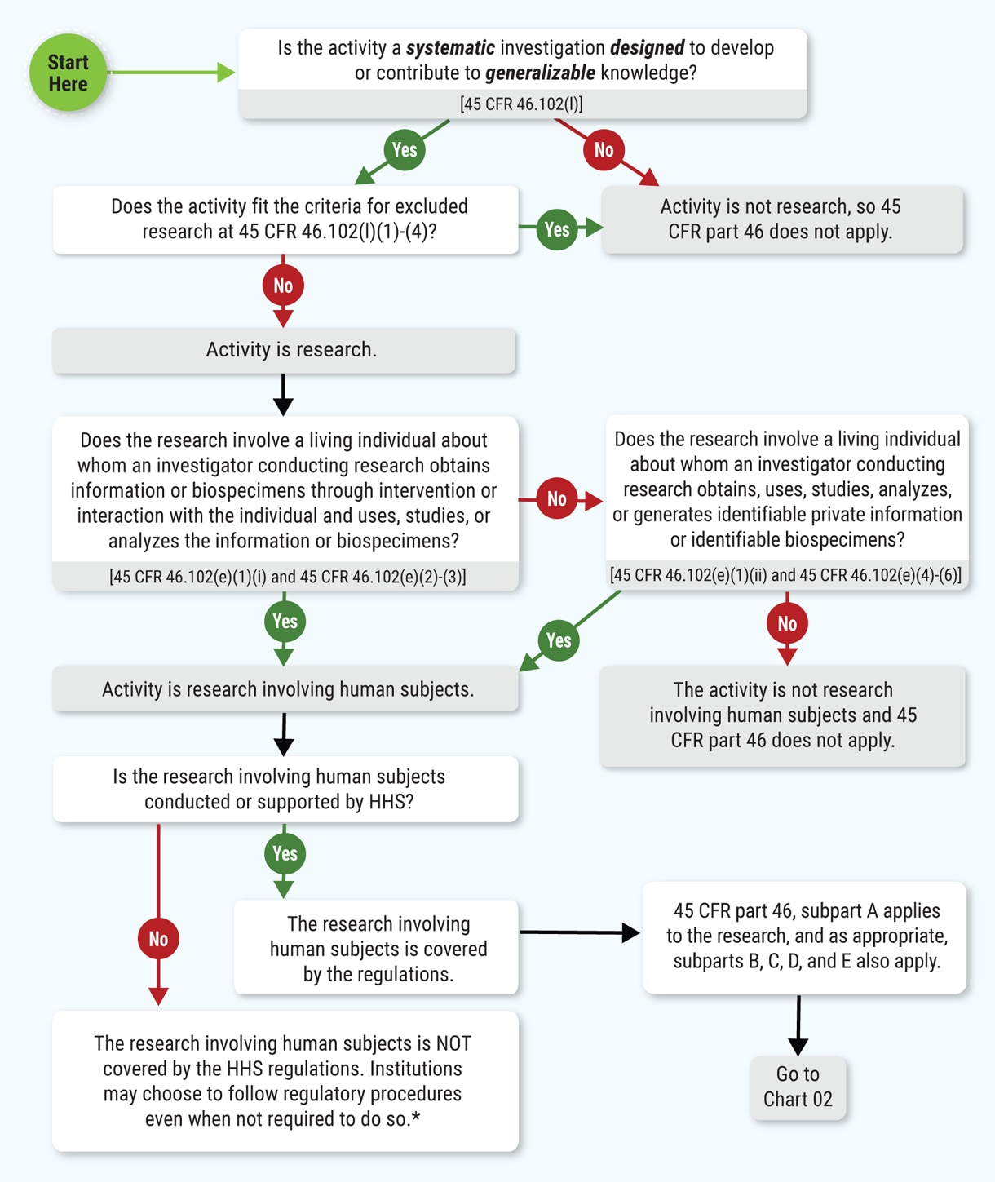
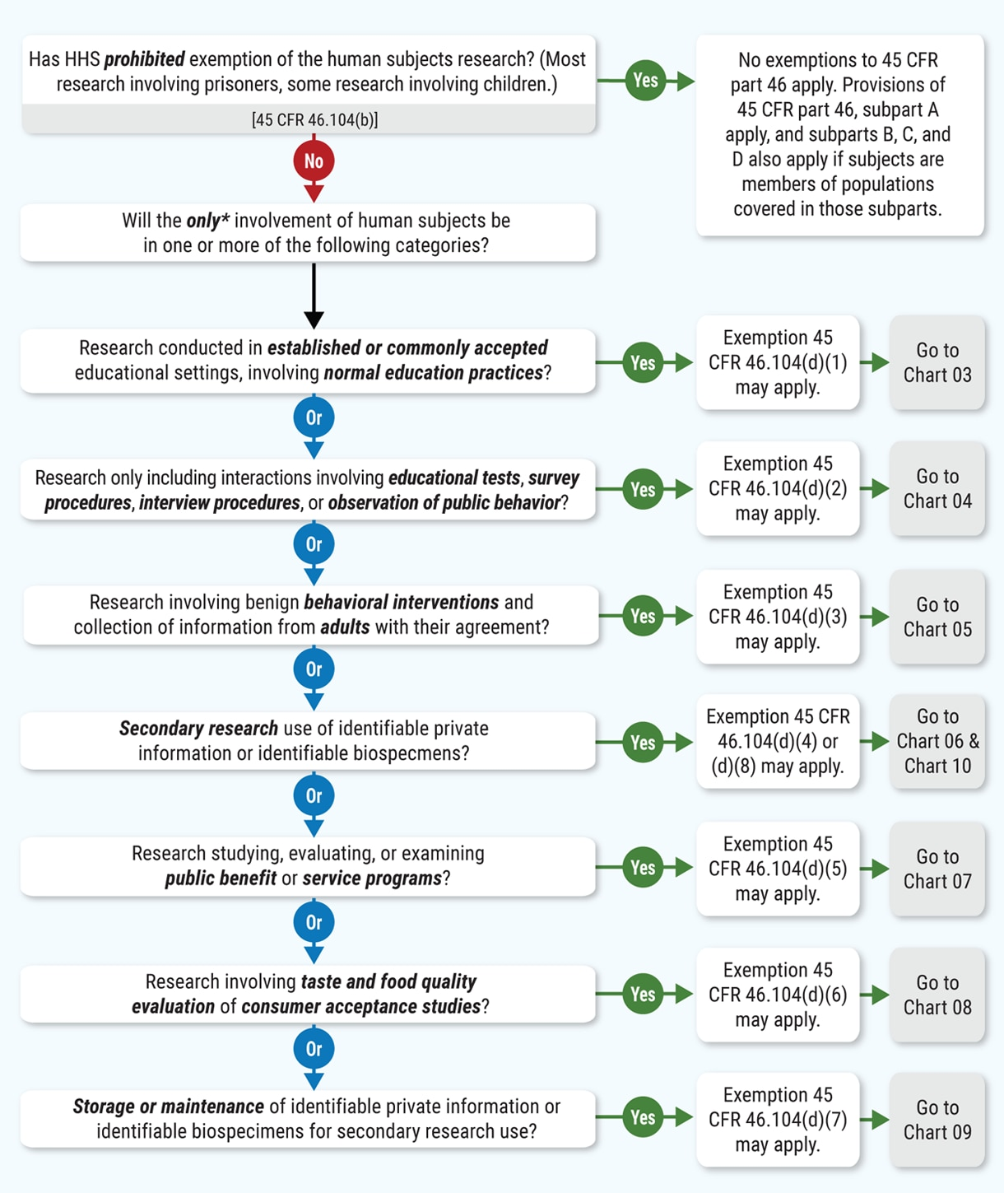
US Department of Health and Human Services (HHS)
Human Subject Regulation Decision Tool
Source: DHHS/OHRP

Slide 21
Additional Protections?
Vulnerable Populations
Secondary Data
Biospecimens
Includes:
Children
Prisoners
Pregnant Women
Individuals with Cognitive impairment
Does not qualify for Exempt Review
Extra considerations for: consent (eg. LAR/Parental consent)
Risk/benefit analysis
Selection is fair and impartial
Could the research feasibly be done without including the vulnerable population?
Could this include any undue influence
Is the data de-identified?
Could the data be re-identified?
Does it require a HIPAA Waiver?
What does the original Consent form language say regarding sharing their data?
Has the PI obtained the permission from the data owner to use the data? (DUA)
Can the PI implement proper data Security measures?
If using AI to analyze the data, what information does the AI retain and use for its algorithms?
Did the PI obtain explicit consent from the participant to store the sample, use for future research?
Does the participant have the ability to ask for their biospecimen to be destroyed?
Do the participants know what their samples will be used for? If a PI is conducting genetic analysis, will this be reported in their medical record?
Are the biospecimens coded in a way that they can no longer be identifiable?
All 3 of these types of research are eligible for a Certificate of Confidentiality (COC) under the NIH or Sponsor

Slide 22
What happens after my protocol has been approved?
Once a protocol has been approved, the PI is permitted to start research activities that involve human subjects.
Engaged Activities: Recruitment, Screening, obtaining Consent, collecting Baseline measures, Randomization, Surveys, Focus Groups, Treatment, Follow up
Protocol Monitoring: The IRB, Sponsor or Federal Agencies may reach out to the PI to periodically monitor or audit the research being conducted to ensure that it is adhering to the regulations.
Amendments: Sometimes changes to the protocol need to be made, including adding team members. All of these changes need to be submitted to the IRB for review and approval before they can be implemented, even for Exempt Research. The IRB re-reviews to make sure there are no increased risks, and the change does not warrant a new protocol be submitted.
Continuing Review: For non-Exempt research, continuing review is typically required (although the 2018 Common Rule, allows IRBs to determine if Expedited research requires continuing review, where Full Board Research has annual Continuing Review Requirements)
Reportable Events: Occasionally a PI deviates from the approved protocol, or a participant experiences an Adverse Event (AE) while enrolled in the research, in these cases it is responsibility of the PI to report the deviation or AE to the IRB as soon as it is brought to the research team’s attention. It is also the responsibility of the PI to document the deviation or AE and follow up with participant until it is resolved

Slide 23
Required Training for Work with Human Subjects
All researchers involved in any human subject research at UMBC must complete human subjects training under through CITI:
https://www.citiprogram.org/
Social/Behavioral Research Course – Appropriate for Graduate Students, Faculty and Staff
Research with pre-existing data, records data or laboratory specimens – Appropriate for researchers with no direct contact with Human subjects and/or Secondary Data Use
GCP – Social and Behavioral Research Best Practices for Clinical Research – Appropriate for researchers conducting research in a clinical setting
GCP for Biomedical Research – Appropriate for researchers working with FDA regulated drug, device or biologic studies.
Health Information Privacy – Required for those working with HIPAA protected Data
Information Security Course – Suggested for all UMBC Researchers
Family Educational Rights and Privacy Act (FERPA) – Suggested for those working with data that is protected under FERPA
Additional guidance and instructions for accessing training can be found here:
https://research.umbc.edu/human-subjects-use-training-2/

Slide 24

Protocol Submission
UMBC uses an electronic protocol submission process for review and approval called Kuali.
Class projects overseen by instructors follow one path:
  Instructors are the Principal Investigators and submit; students are required to complete CITI training and follow the course specific requirements. Classroom projects can not fall under Expedited or Full Board Research
Research outside of the classroom:
  Student’s can be Principal Investigators, complete and submit applications and follow the IRBs requirements. Students will need to list their faculty advisor on the protocol and have their faculty advisor sign off on the protocol prior to submission
Review the Kuali IRB User Guide to assist with the application

Slide 25
Required Protocol Elements
Kuali IRB Application - https://umbc.kuali.co/protocols/
Project Narrative/ Lay Summary
  This should include your hypothesis and the background information that supports your hypotheses
Personnel
  This should include anyone, including your faculty advisor, who will be working on your protocol
  You will need your faculty advisor to review the protocol with you, and sign off on the IRB Faculty Advisor Certification prior to submitting to the IRB.
CITI Human Subjects Training - https://research.umbc.edu/human-subjects-use-training-2/
Procedures
  This should include the step by step process that includes how you will recruit participants, consent them, where everything will be done, all survey/interview/intervention details
Participants
  Includes your eligibility criteria, screening tools, how many people you plan to recruit and if they will be randomized
Informed Consent Procedures and Documents
  Informed consent is the process of providing a subject with adequate information to allow for an informed decision about his or her voluntary participation in the research.
  UMBC Consent Templates - https://research.umbc.edu/consent-and-assent-guidelines/
Data Collection Tools
  Include copies of any survey(s), interview questions or checklists, forms or other data collection tools
Recruitment Plan and Materials
  How you plan to engage participants in your research
  Include copies of any social media scripts, email/letter template, posters/advertisements, etc.

Slide 26
Student Specific Considerations for IRB Approval
Faculty Advisors need to take an active role in your research. This includes:
Adding them to the people section of the protocol with full permissions in Kuali
Faculty Advisors are ultimately responsible for reviewing your protocol prior to submission. Once they have reviewed the protocol, they will need to sign and attach the Faculty Advisor IRB Protocol Certification Form
Your Faculty Advisor will also need to take and maintain their CITI training.
At the end of the study, all data, protocol files, consent forms need to remain with your faculty advisor. If you have a non-Exempt protocol, we will ask you to ensure a copy of all files remains on campus after you leave UMBC.
Secondary Data:
If you will be using data from a source that is not your advisor and is not publicly available, you will need your Faculty Advisor to obtain a Data Use Agreement through Sponsored Programs. Students and faculty can not sign on behalf of UMBC for use of private data generated or owned by another organization.
Using data from research prior to IRB approval:
The IRB does NOT have the authority to grant retroactive approval. If you conduct research with human subjects prior to IRB approval or determination, you will need to destroy the unsanctioned data and records, obtain approval and start over.

Slide 27
What to Expect: UMBC IRB Review Process
All protocols must be reviewed and approved by your faculty advisor/mentor prior to submission to the IRB.
Review Process timelines:
  2-3 weeks for Exempt
  4-6 weeks for Expedited
  Full Board protocols need to be submitted in Kuali for review 30 days prior to IRB committee meetings (1st Monday of Feb/Apr/Jun/Oct/Dec)
NO RESEARCH is PERMITTED until you receive IRB APPROVAL

Slide 28
Who to Contact?
For More Information about UMBC IRB:
Visit: https://research.umbc.edu/institutional-review-board-human-subjects/
Email: irb@umbc.edu
To report a suspected research violation at UMBC:
Visit:
https://research.umbc.edu/research-compliance-feedback-and-reporting-research-concerns/
Phone: 410-455-2737
Email: researchintegrity@umbc.edu
Anonymous form: https://forms.gle/MLeHKKeYMB58ywrT7

